Slide 1
DIE- LGBTQ Rights
Love Story
Romantic Drama

Slide 2
Characters
Annie – Main Character
Girl who gets bullied because she is a lesbian
Runs away from school and moves to more LGBTQ friendly area
Sarah – Main bully
Kim and Vanessa – two weaker bullies just follow Sarah’s lead, later fall in love with each other
Mom and Dad
Supportive loving parents who will do anything to protect and support their daughters
Older Sister
Successful political woman/activist
Annie’s best friend

Slide 3
Summary
Annie, a lesbian girl in middle school, has a loving and supportive family. She is very close with her sister and her parents. Annie had a history of being bullied for her sexuality, especially by a clique of three beautiful girls who seemed to think they ran the school, Sarah, Vanessa, and Kim. The bullying only got worse as middle school came to an end. Annie had been letting her grades drop and isolating herself more. She copes by painting. One day Annie found a twitter made to cyberbully Annie and post homophobic memes. Her and her sister tracked the IP address to Sarah’s address. Annie reported the twitter and on the last day of middle school she confronted Sarah. Sarah denied that she was the one running the twitter account and the conversation rose to yelling and screaming. The user gets three choices as Annie: slap Sarah, Lick/kiss Sarah, or snap her fingers and make her disappear… She came home that day empowered and sat her parents down for a serious talk where she said that she wanted to move cities. She was going to move in with her grandparents if the family did not want to move for her high school years. Annie’s mom and dad decided to move to Seattle where they knew that Annie would not be judged for her sexuality. She fell in love their and is now happily married to another woman and is a huge advocate for equality and her own nonprofit to support the LGBTQ community. The biggest bully ended up with no friends, no lover and miserable for the rest of their life while the two back up bullies begin dating and fall in love, obviously excluding Sarah from their life completely.

Slide 4
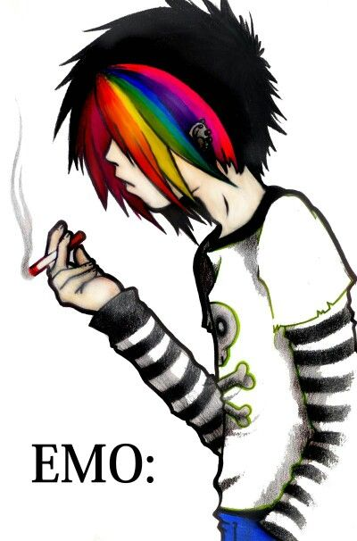
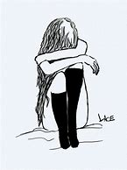
Annie
Long hair, white with rainbow bangs

Slide 5
Problem
Annie is being bullied because she is openly gay.
She lives in a very Christian town.
She has rainbow hair and dresses more abstract than her classmates.
She stands out.

Slide 6
Solution
Annie copes by painting.
Eventually Annie had enough and stood up to the bullies.
She produced a plan, either to have her family move or she would live with her grandparents.
The family decided to move to Seattle.
Annie joined an LGBTQ support group, fell in love, and realized how terrible the bullies from her school were.
She decided to choose a career where she could promote and work for LGBTQ rights.

Slide 7
Interactivity
Fight breaks out when Sarah denies that she has created the Twitter trashing Annie. The following choices are given to the user:
User slaps Sarah, the bully.
User kisses/licks the bully.
User presses a button that sends Sarah into mysterious tunnel underground where she cannot escape.

Slide 8
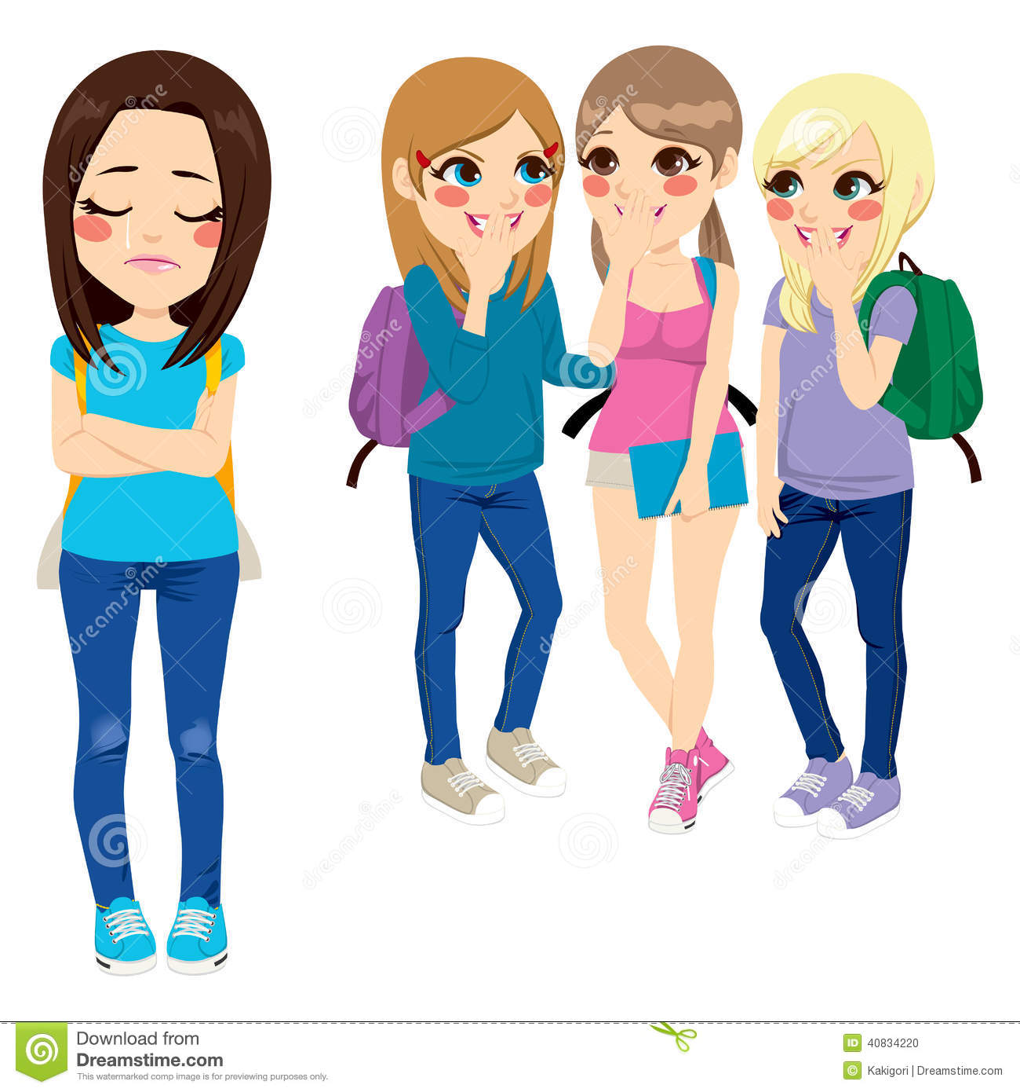
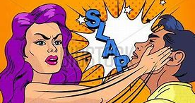
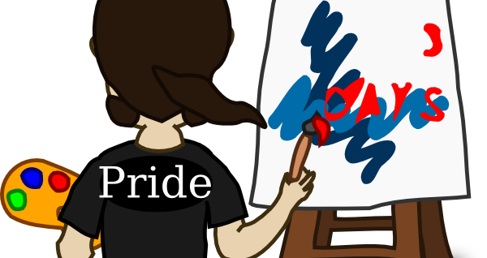
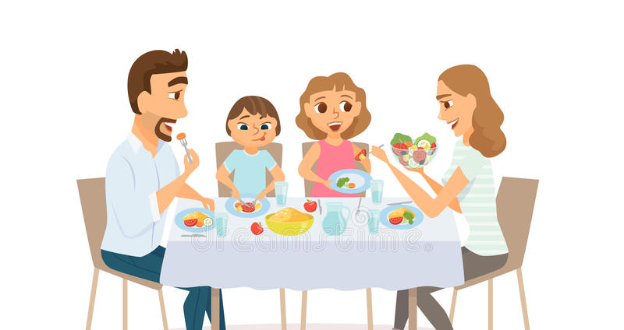
Mood board

Slide 9
Ethical challenges
Bias – maybe someone does not like my story because they are homophobic or religious
Improper distance – Maybe someone gets triggered or angry because they were bullied/discriminated due to their sexuality

Slide 10
Solutions to ethical problem
Inform the audience that
Switching POV… have user be Annie some scenes and 3rd person in some other scenes
Make only one controller useable

Slide 11
Major moments - Scenes
Close knit family - eating at dinner, happy
Copes with depression by Art
Slapping bully (interactable), or kisses/licks, snaps and makes her dissapear
Conversation with parents – whole family moves or Annie moves in with grandparents
Marries a girl and starts working with nonprofit for LGBTQ rights
Sees bullying twitter (1st person)
Shows bullying twitter to sister/they come up with plan

