Slide 1
Spear Shooter
VR Creative Portfolio

Slide 2
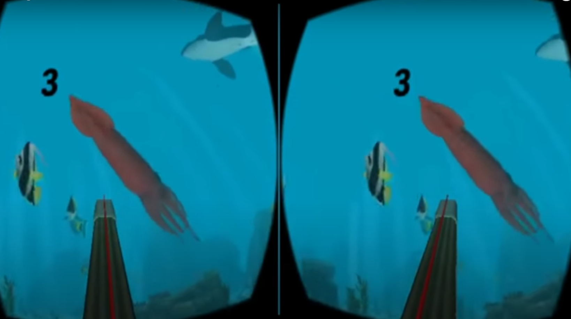
Introduction
Name: Spear Shooter
Intro: In this game the user will go free diving with a speargun and shoot fish!
What is it? Virtual Reality Spearfishing FPS

Slide 3
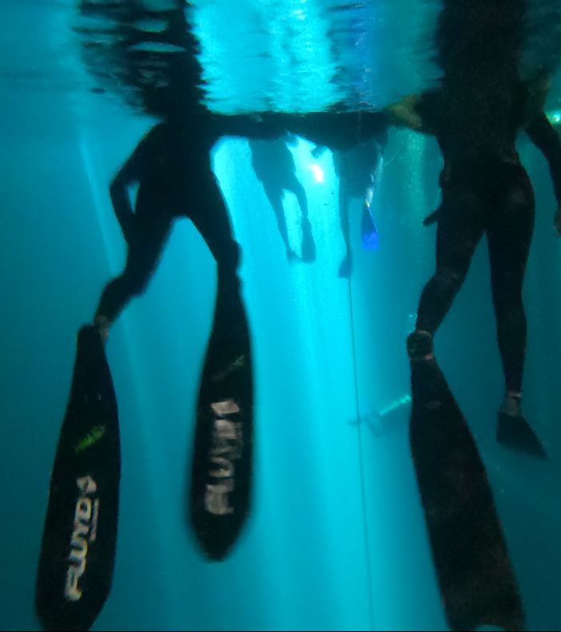
Theme
Theme/style: FPS, Ocean, Meditation
Inspiration: I am a free diver
Why: Because real spearfishing can be so boring but when you see fish constantly, it could be super fun!!!

Slide 4
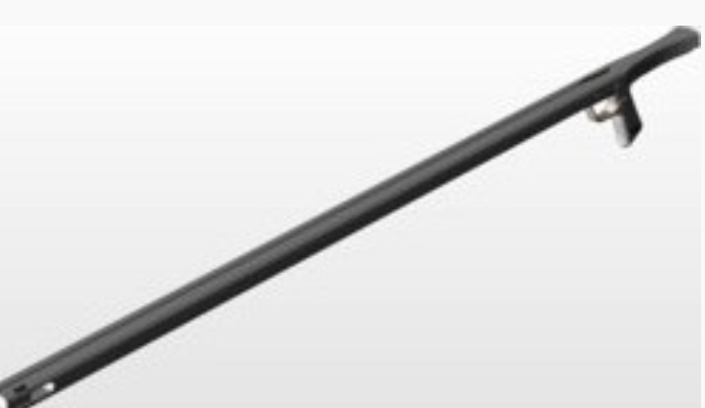
Gameplay
Aim down fish: using left grip button
Shoot: using trigger button
Gun model: Speargun 3d model (3dmdb.com)
UI appears when fish is shot with stats of fish
Potentially add different button mechanics and maybe reel fish in

Slide 5
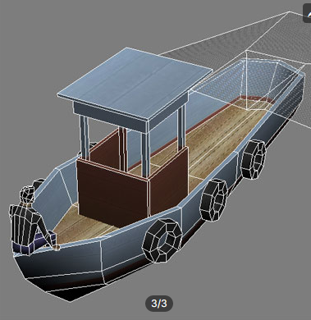
entrance
User jumps off boat

Slide 6
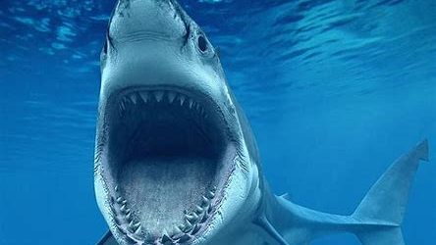
Mechanic
Two Handed Weapons using Unity's XR Toolkit [02] – YouTube
Replace this VR FPS with a speargun and make the bullets little spears
- Shark swim up and eat you to end game

Slide 7
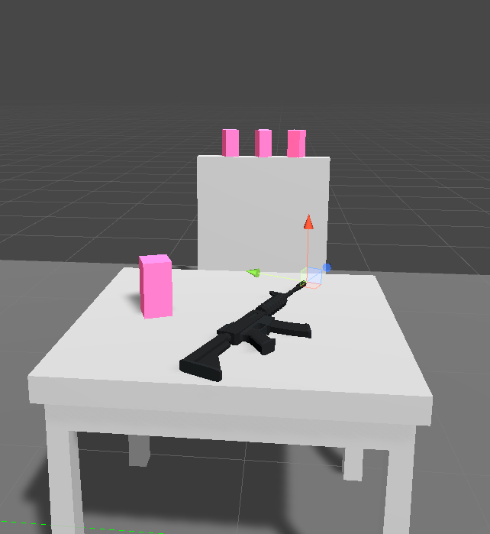
Next Step
- Get gun to shoot
- Create Water environment

Slide 8
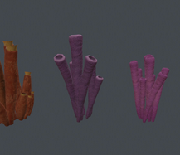
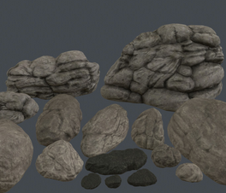
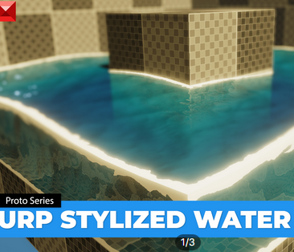
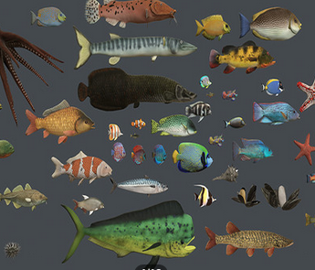
Why VR?
I wanted this project to be in VR because I feel like shooting a speargun in VR where it can directly follow your movements is a lot more realistic than a mouse in keyboard or game controller.

